Slide 1
Asset Pipeline
of Fools Engine
Work in progress

Slide 2
Storage structure
Editor and Game
Assets are broken down into components and stored in ECS.
AssetManager creates assets and decides what to load and what to unload.
Asset Types:
Texture,
Texture2D,
Shader,
ShadingModel,
Material,
Mesh,
RenderMesh,
Model,
Skeleton,
SkinnedModel,
Animation,
Scene,
Prefab,
Audio
AssetsManager
ECS

Slide 3
Rendering Assets
ShadingModel
Shader
Shader parameters (samplers, uniforms)
Material
ShadingModel
N × Texture
Uniform Values
Mesh
Vertices and Indices
RenderMesh
Mesh
Material
Model
N × RenderMesh
Skeleton
Hierarchy of transforms with default values (base pose)
SkinnedModel
Skeleton
Model
Skinning

Slide 4
Scene Components for Mesh Assets
CRenderMeshView
Mesh
Material
CRenderMesh
RenderMesh
CModelView
N × RenderMesh
CModel
Model
CSkinnedModelView
Skeleton
N × RenderMesh
Skinning
CSkinnedModel
SkinnedModel

Slide 5
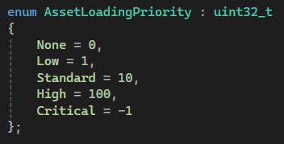
Runtime Management
Editor and Game
Centralized streaming:
You can never assume an asset is loaded and there is no explicit asset loading request possibility. Instead, a handle to the asset has a loading priority value - enum. Asset handles of each loading priority are atomically counted in a component of that asset (reference counting). Asset Manager uses those counts to decide centrally which assets to load and unload:
Calculates score of each asset as ∑ of count*priority
Sorts assets based on their’s scores:
Load as many assets as much memory is available going from the highest score down (and unloading going from lowest score up).
This makes dynamic adaptive asset loading management much easier and safer (e.g. preloading assets for next level simply by setting their handles from None to Low). Asset loading/unloading and score calculation/sorting runs in an asynchronous loop, but in a foreground (structured concurrency).

Slide 6
Access
AssetInterface
Generic interface to ECS
Observer
TextureObserver
TextureUser
User
Interface to a concrete Asset
Public only methods specific to its asset type
Can be conceptualized as an asset itself, but actually is just an ECS handle (Asset ID + Registry ptr)
Treats Asset as const
Extends Observer adding methods modifying an Asset
ShaderObserver
ShaderUser
MaterialObserver
MaterialUser
AudioObserver
AudioUser
AssetHandle< tnAsset >
AssetID + AssetLoadingPriority
.Observe()
.Use()
AssetObserver< tnAsset >
AssetUser< tnAsset >
Common (templated) derivation of all observers
Acting like a shared lock guard
Common (templated) derivation of all users
Acting like a unique lock guard

Slide 7
Synchronization
AssetHandle< tnAsset >
AssetID + AssetLoadingPriority
Observer constructor
Observing
User constructor
.Observe()
.Use()
AssetObserver< tnAsset >
AssetUser< tnAsset >
End
Acting like a shared lock guard
Acting like a unique lock guard
Mutex A
End
Observer() Lock Mutex A Observers Count ++ If 2. was 0->1 Lock Mutex B Unlock Mutex A | User() Lock Mutex A Lock Mutex B
~Observer() Observers Count -- If 1. was 1->0 Unlock Mutex B | ~User() Unlock Mutex B Unlock Mutex A
Mutex B
Count > 1
Count == 1
Count == 0
Count > 0
Using
Atomic Observers Count

Slide 8
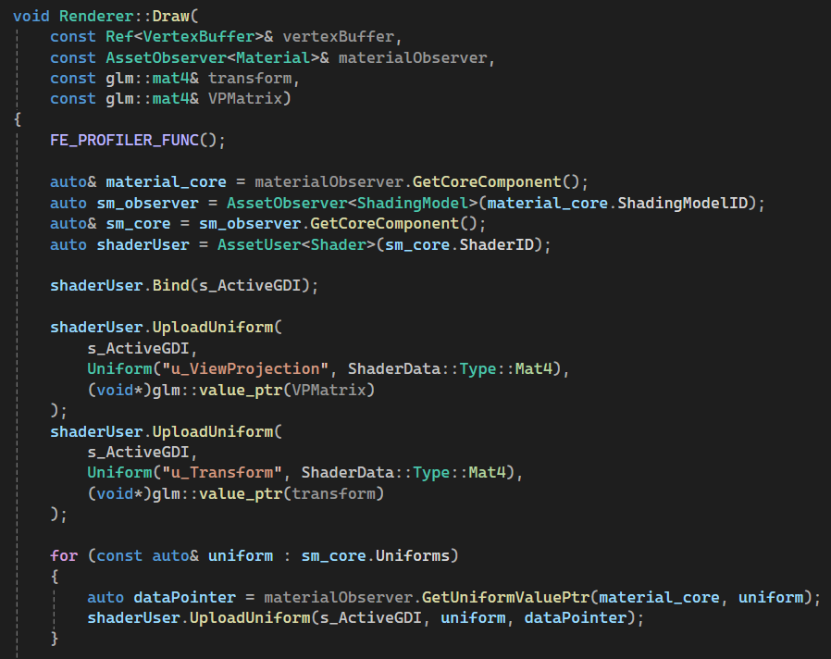
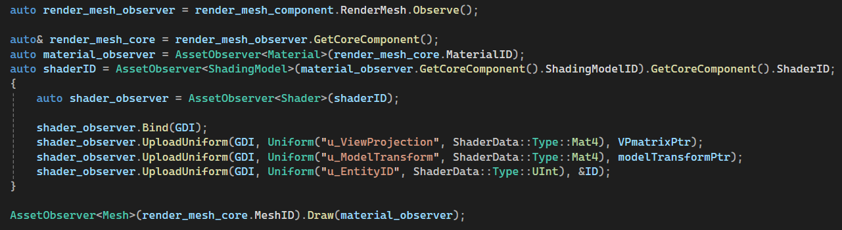
Synchronized Runtime Access
Examples

